Slide 1
ePortfolios and Outcomes Assessment
Susan Kahn, Ph.D.
Director, Institutional Effectiveness
Director, Electronic Portfolio Initiative
Indiana University-Purdue University Indianapolis
Learning Outcomes Assessment for International Education Programs
Meiji University, May 18, 2012

Slide 2
What is an ePortfolio?
“Student portfolios can be succinctly defined as collections of work selected from a larger archive of work, upon which the student has reflected.” (Yancey, 2001)
“A collection of electronic evidence assembled and managed by a user, usually on the Web.” (Wikipedia)
“A selection of purposefully organized artifacts that supports learning, reflective practice, and self-presentation, as well as documentation and assessment of student learning over time and across varied learning experiences.” (IUPUI definition)

Slide 3
Wendling Welcome
Notes:
3

Slide 5
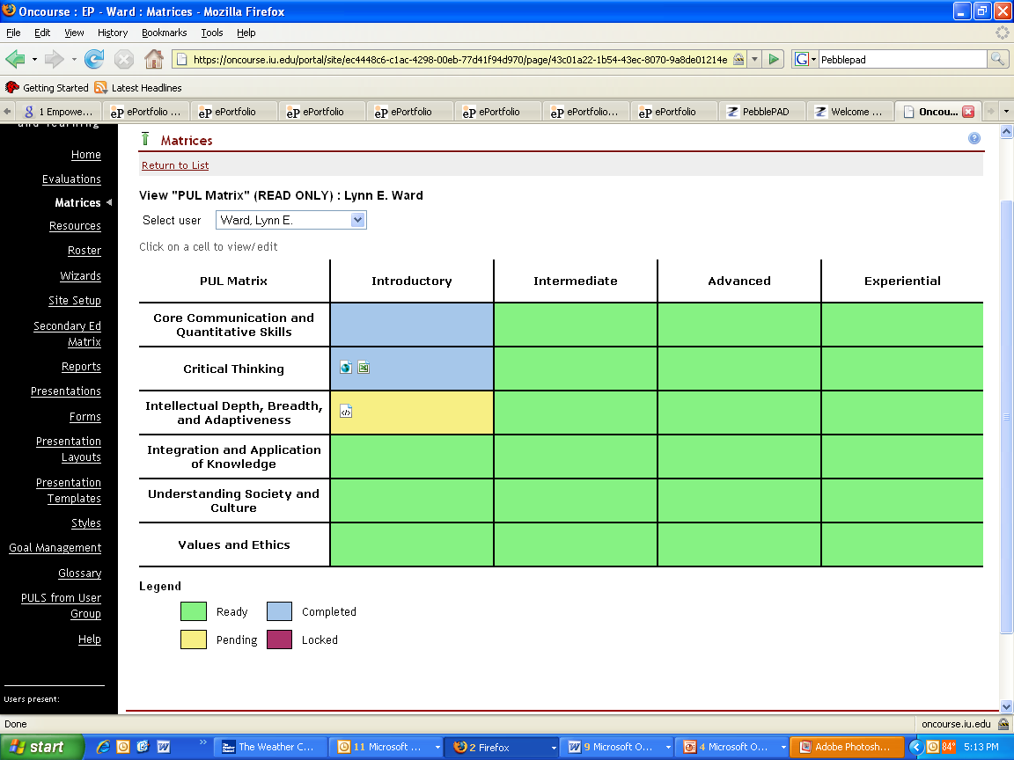
Notes:
5

Slide 6
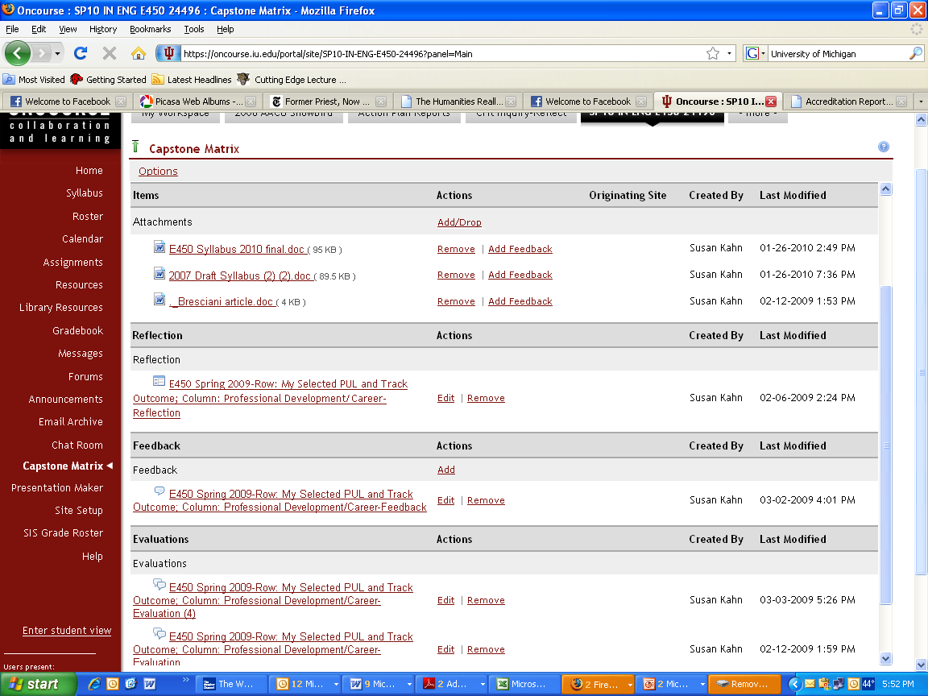

Slide 7
How are ePortfolios Used?
Teaching & Learning
Self-Representation & Identity Development
Accountability & Assessment

Slide 8
Purposes of ePortfolios
By students
Document and demonstrate development and achievement
Create and manage digital identity
Integrate and apply learning
Increase engagement in learning
By faculty
Track development of students’ abilities over time
Enable assessment of broader set of abilities and skills
Provide rich, contextualized information and insights to guide curriculum/program development and improvement
By departments, programs, and institutions
Support academic and career advising
Enable authentic and rigorous assessment for admissions, program improvement, accreditation and accountability

Slide 9
What goes into an ePortfolio?
Examples of work in multiple media (showing development or “best work”)
Resumes
Plans and goals
Reflections (usually written)
Recommendations and evaluations

Slide 10
Authentic assessment
A measurement approach in which learning objectives are assessed in the most direct, relevant means possible….Authentic assessments are often based on performance, requiring students to utilize their knowledge in a meaningful context. (Park University, Center for Excellence in Teaching and Learning)

Slide 11
Advantages for Assessment
“Documenting learning in this way places the focus on actual achievements that are viewed directly, rather than on proxies of achievement like cumulative GPAs or test scores that are only indirect indicators of learning. The focus is also on what students can do with their knowledge and skills and not simply on whether knowledge has been acquired.” (Huba & Freed, 2000)

Slide 12
Beyond Authentic Assessment
More than the sum of its parts
Can demonstrate a trajectory of learning and growth over time
Can capture complex cognitive and affective outcomes
Provide richer, more contextualized information to guide curriculum/program improvement

Slide 13
Rubrics
“Rubric” = A set of criteria or “rules” for scoring or rating a product or performance
Typically intended to standardize evaluation of a set of authentic pieces of work
Identifies characteristics or components of the outcome being assessed
Describes levels of performance for each component

Slide 14
Reflection
Metacognition
Self-examination/assessment
Re-processing ideas to support understanding
Questioning assumptions
Seeing in multiple contexts, from multiple perspectives
Making connections, integrating ideas

Slide 15
Development in Reflective Thinking
Ability to self-assess
Awareness of how one learns
Development of lifelong learning skills

Slide 16
IslamY107 exemplifies my ability to be a critical thinker because I had to put forth significant effort to separate my emotion from the facts and research…. Every class that I have taken in political science, English, and philosophy has emphasized the importance of looking past the surface of things. Additionally, my education in the liberal arts has taught me that there is much more to things than what my emotions tell me there are. There is an entire world of people out there, each person possessing a uniqueness of mind and emotional experience. There are several cultures and societies that need to be taken into consideration before my own. My emotions are only central to my own experiences, and my critical thinking skills allow me to leap outside of my own experiences.

Slide 17
Implementation Issues
How will the portfolio be customized to fulfill the institution’s or department’s purposes?
How will the portfolio be integrated into program curricula? What changes will this require?
Who will read and evaluate student portfolios? When?
What are the infrastructure needs? What resources are needed?
What faculty development is needed? What skills will students need to develop?

Slide 18
For more information:
Association for Authentic, Experiential, and Evidence-Based Learning (AAEEBL) www.aeebl.org
Conference: July 16-19, Boston
Susan Kahn
(317) 278-3604
skahn@iupui.edu

