Slide 1
Measuring Comprehensive
Internationalization in U.S.
Higher Education
Barbara Hill Senior Associate for Internationalization ACE Center for Internationalization and Global Engagement (CIGE)
Notes:
Need to introduce self as having been a faculty member at several institutions, then a dean at one, chief academic officer at another, and the president of a yet another U.S. institution. This mobility from one institution to another is typical of leadership in U.S. higher education.
Research…the goal of which is to assess the current state of internationalization on U.S. campuses, as well as progress over time.

Slide 2
Overview of U.S. Higher Education
Big, complex enterprise
No Ministry of Education
Federal government provides a lot of money for research and student financial aid and uses different mechanisms for support
2

Slide 3
Distribution of U.S. Higher Education by Sector
 | Public | Private
Two-year | Community Colleges 1,024 Institutions (32%) 7,593,600 Students (40%) | Junior Colleges 634 Institutions (20%) 483,717 Students (3%)
Four-year | State Colleges 370 Institutions (12%) 2,994,872 Students (16%) | Liberal Arts Colleges 862 Institutions (27%) 2,433,188 Students (13%)
University | Research Universities 168 Institutions (5%) 3,949,737 Students (21%) | Research Universities 112 Institutions (4%) 1,617,918 Students (8%)
Source: Department of Education, IPEDS 2010
Notes:
Source: Department of Education, IPEDS

Slide 4
Thinking Strategically about the U.S. Approach to Internationalization and Student Global Learning
CIGE Model for Comprehensive Internationalization
The Internationalization Laboratory, The Leadership Network for International Education,
And
The Internationalization Collaborative

Slide 5
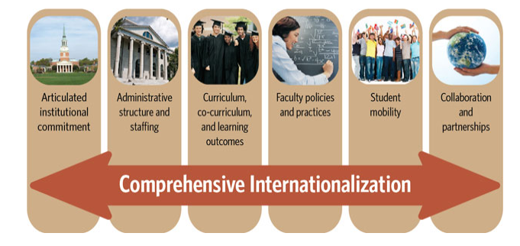
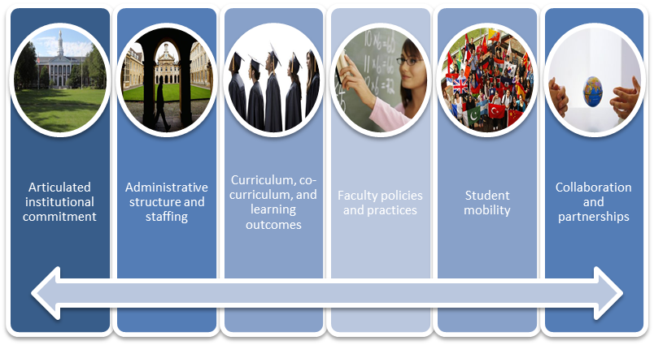
The CIGE Model for Comprehensive Internationalization
Notes:
1. The term “comprehensive internationalization” has been around for a while – this is ACE’s definition:
Comprehensive internationalization is a strategic, coordinated process that seeks to align and integrate policies, programs, and initiatives to position colleges and universities as more globally oriented and internationally connected institutions.
ACE first used the term “comprehensive internationalization” in a 2002 publication Promising Practices: Spotlighting Excellence in Comprehensive Internationalization. In 2003 NAFSA began awarding the “Senator Paul Simon Award for Comprehensive Internationalization”. So the term is rather standard in the United States.
2. Comprised of 6 interconnected target areas for programs and policies.
3. Process plays out very differently at different types of institutions, and not all will be as active in all of these areas. BUT, all of them need attention and consideration as part of the strategic internationalization process.

Slide 6
10 Years of Mapping Internationalization
Survey administered in 2001, 2006 & 2011
Between 750 and 1050 respondents (31-50% response rate)
Includes a range of institution types:
Associates (community colleges)
Baccalaureate (4-year liberal arts)
Master’s
Doctoral
“Special focus” added in 2011
Sent to Senior International Officer (SIO)
Notes:
…but a variety of people actually complete the survey

Slide 7
Key Findings
Majority of institutions report that internationalization has accelerated (93% doctoral, 84% master’s, 78% baccalaureate, ~50% two year colleges and special focus institutions).
Among institutions with an accelerated focus:
President/CEO seen as most common catalyst for spurring internationalization.
Funding for internationalization has increased (47%) or remained steady (27%).

Slide 8
Area of Progress #1: Assessment of Internationalization
37% of institutions have formally assessed the impact or progress of internationalization.
Up from 30% in 2006
55% have developed specific international/global student learning outcomes.
Up by 10 percentage points since 2006
Notes:
Assessment is part of institutional structures and support and indicates that institutions are making an effort to set concrete goals and hold themselves accountable for progress.

Slide 9
Area of Progress # 2: Faculty Hiring
68% of institutions are considering international background, experience, and interests in hiring faculty in fields that are not explicitly international or global.
Up sharply from 32% in 2006
Notes:
Faculty are the drivers of teaching, learning, and research, so internationally competent faculty are key to internationalization efforts

Slide 10
Area of Progress # 3: Student Mobility
Over half (54%) of institutions administer their own undergraduate study abroad programs.
More institutions are providing:
Scholarships for study abroad
Funding for faculty to take students abroad
Funding for international student recruiting
Scholarships for international students
Notes:
“Student mobility” -- U.S. students going abroad and international students coming to U.S. institutions
Has been a major focus of internationalization efforts over time and continues to be now, but it is only 1 of 6 areas of comprehensive internationalization.

Slide 11
Reality Check #1: Faculty Support
Only 8% of institutions have guidelines specifying international work or experience as a consideration for tenure.
No change since 2006, up from 6% in 2001.
Fewer institutions provide:
Opportunities to improve foreign language skills
Professional development workshops
Funding for travel to meetings and conferences abroad
Funding to study or conduct research abroad
Notes:
Many demands on faculty time, so if they’re not rewarded in the tenure process, they may see international activities as difficult to justify.
Without international professional development opportunities and on-campus support, it’s difficult for faculty to gain international competence and learn how to translate their international background and experiences into the classroom. Ultimately students’ international competence and ability to achieve student learning outcomes suffers.

Slide 12
Reality Check # 2: Curriculum
Mixed picture for general education requirements:
More institutions require undergrads to take courses that feature global trends and issues
Fewer require courses that feature perspectives, issues and events from outside the U.S.
Steady decline in foreign language requirements
Notes:
global health, environmental issues, etc.
Implications for study abroad…most U.S. students want to go where university instruction is conducted in English.

Slide 13
Reality Check # 3: Support for International Students
Recruiting efforts up, but little commensurate increase in support services and programming.

Slide 14
ACE Programming to Assist U.S. Higher Education Achieve Comprehensive Internationalization
Internationalization Laboratory
Leadership Network for International Education
Internationalization Collaborative
Resources on ACE web site
Notes:
If the research shows that U.S. institutions have mixed results in achieving comprehensive internationalization, what can a higher education organization do to encourage better performance?

Slide 15
ACE’s Internationalization Laboratory
The Internationalization Laboratory is an invitational learning community that assists participating institutions to develop a capacity, capability, and strategy for comprehensive internationalization.
Involvement lasts 16-20 months.
Notes:
Begun in 2003, so far ACE has had 10 cohorts comprised of 68 institutions. The eleventh cohort is currently being organized.

Slide 16
Organization of the Lab
Each institution forms an internationalization leadership team on campus.
Each team sends representatives to three learning community meetings in Washington, DC, to share information and to do problem-solving.
Each team does on-campus work of an internationalization review, development of student learning outcomes, and creation of an internationalization strategic plan.
Each campus hosts a site visit to begin the Lab process and a peer review visit at the completion of Lab
Each campus gets monthly consultations with the Lab director to assess progress in completing Lab activities

Slide 17
On-campus Work of the Lab
An internationalization review to catalog and analyze what the institution is currently doing
The articulation of student global learning goals and a method to understand how the institution’s activities impact student learning
The integration of the results of the review and the learning goals process into a strategic internationalization plan

Slide 18
Internationalization Review
Taking stock of the current international and global initiatives on campus
Collecting and analyzing information as a basis for an internationalization strategic plan
Identifying possibilities for new strategic activities
Engaging people across the institution in a discussion of internationalization

Slide 19
What does articulating global learning goals add to the review process?
Offers a guide for aligning curriculum and other activities with desired goals for students
Helps prioritize activities in an internationalization plan
Encourages a culture of quality improvement
Helps stakeholders understand the impact of institutional activities

Slide 20
Basic Questions for Articulating Student Global Learning Goals
What do we want our students to know and be able to do? (knowledge, skills, attitudes)
Where would students acquire this knowledge and these skills and attitudes?
What is our evidence that students are actually achieving these outcomes?
Notes:
By comparing aspirations for student learning and what the institution actually does, institutions can see what they need to do to make internationalization real on their campuses. This forms the basis of the internationalization strategic plan.

Slide 21
Elements of an Internationalization Strategic Plan
Vision for Internationalization
Strategic Goals
Performance Indicators – Outcomes and Evidence of Success
Specific Action Steps and Timeline
Responsible Agents (though this may be in a later implementation plan)
Funding
Plan for monitoring implementation

Slide 22
Comprehensive Internationalization is not just “What are we doing?”
Study Abroad
International students and scholars
Linkages/institutional partnerships and exchanges
Long-distance education (virtual study abroad) and internationalized courses
Area Studies programs
Foreign Languages
International Studies (interdisciplinary)
International Business (multi-regional, discipline-based)
Research collaboration
Dual and joint degree programs
Outreach
Cross-cultural events and training
& etc…….

Slide 23
Comprehensive internationalization answers “Why are we doing this?”
Preparing students for global citizenship
Making students more competitive in the global marketplace
Enhancing institutional reputation and competitive position
Enhancing the research agenda
Strengthening engagement that promotes the application of knowledge
Making a better, more understanding world

Slide 24
Leadership Network for International Education
One-day annual meeting in fall.
Professional development for presidents, chief academic officers, and senior international officers.
Forum on institutional strategies for senior decision makers.
Focus on the challenges to implementing comprehensive internationalization strategies, especially global engagement.
Emphasizes resources available to institutions, especially in Washington, DC from government agencies, non-profit foundations, and embassies from other countries.
Notes:
Leadership Network for International Education December 2012 The Globally Engaged Institution: Washington Connections
Global Engagement: A View from Ambassador of India to the United States.
Global Competition and Student Recruitment panel (views from United Kingdom, Canada, and Australia).
Resources panel for Global Engagement panel (U.S. Department of Education, National Science Foundation, Higher Education for Development, U.S. Department of State.
Mapping Report on Global Engagement of U.S. Higher Education: Study 2011.
Presidential panel on how ACE Lab guides institutions to maximize their global engagement.

Slide 25
The ACE Internationalization Collaborative
One-day annual meeting in spring.
Continuing professional development for senior administrators and faculty leaders in a learning community.
Forum on institutional strategies.
Focus on the challenges to implementing comprehensive internationalization strategies.
Guidance from an Advisory Council that serves as a liaison to other collaborative members and provides direction for Collaborative activities.
Notes:
Internationalization Collaborative February 2013 Aligning International Strategy and Institutional Goals
Morning plenary panel of university presidents who will share their experiences with strategic planning and internationalization on their campuses.
Afternoon plenary panel of senior internationalization leaders will explore the same issues from their perspective.
small sector group discussions on good practices to allow institutions to share experiences.
Beginning this year, participants will also have the opportunity to collaborate electronically after the meeting.

Slide 26
Further ACE Web Resources on Comprehensive Internationalization
Best practices and tools on ACE web site (www.acenet.edu)
Research reports
Webinar series with accompanying printed brief on practical topics, including how to engage with different regions of the world

Slide 27
Thank you.
Dr. Barbara A. Hill
Senior Associate for Internationalization
bhill@acenet.edu

